Slide 1
cond….
Testing Conventional Applications

Slide 2
Testability
Operability—it operates cleanly
Observability—the results of each test case are readily observed
Controllability—the degree to which testing can be automated and optimized
Decomposability—testing can be targeted
Simplicity—reduce complex architecture and logic to simplify tests
Stability—few changes are requested during testing
Understandability—of the design

Slide 3
What is a “Good” Test?
A good test has a high probability of finding an error
A good test is not redundant.
A good test should be “best of breed”
A good test should be neither too simple nor too complex

Slide 4
Internal and External Views
Any engineered product (and most other things) can be tested in one of two ways:
  Knowing the specified function that a product has been designed to perform, tests can be conducted that demonstrate each function is fully operational while at the same time searching for errors in each function;
  Knowing the internal workings of a product, tests can be conducted to ensure that "all gears mesh," that is, internal operations are performed according to specifications and all internal components have been adequately exercised.

Slide 5
Test Case Design
"Bugs lurk in corners
and congregate at
boundaries ..."
Boris Beizer
OBJECTIVE
to uncover errors
CRITERIA
in a complete manner
CONSTRAINT
with a minimum of effort and time

Slide 6
Exhaustive Testing
Exhaustive testing is a test approach in which all possible data combinations are used for testing
loop < 20 X
14
There are 10 possible paths! If we execute one
test per millisecond, it would take 3,170 years to
test this program!!

Slide 7
Selective Testing
Testing only a selected set of program paths and data inputs.
Selected path
loop < 20 X

Slide 8
Software Testing
white-box
methods
black-box
methods
Methods
Strategies

Slide 9

White-Box Testing
... our goal is to ensure that all
statements and conditions have
been executed at least once ...

Slide 10
Why Cover all Paths?
logic errors and incorrect assumptions
are inversely proportional to a path's
execution probability
we often
believe
that a path is not
likely to be executed; in fact, reality is
often counter intuitive
typographical errors are random; it's
likely that untested paths will contain
some

Slide 11
Basis Path Testing
First, we compute the cyclomatic
complexity:
number of simple decisions + 1
or
number of enclosed areas + 1
In this case, V(G) = 4

Slide 12
Cyclomatic Complexity
A number of industry studies have indicated
that the higher V(G), the higher the probability
or errors.
modules
V(G)
modules in this range are
more error prone

Slide 13
Basis Path Testing
1
Next, we derive the
independent paths:
Since V(G) = 4,
2
there are four paths
3
Path 1: 1,2,3,6,7,8
4
Path 2: 1,2,3,5,7,8
5
6
Path 3: 1,2,4,7,8
Path 4: 1,2,4,7,2,4,...7,8
Finally, we derive test
7
cases to exercise these
paths.
8

Slide 14
Basis Path Testing Notes
you don't need a flow chart,
but the picture will help when
you trace program paths
count each simple logical test,
compound tests count as 2 or
more
basis path testing should be
applied to critical modules

Slide 15
Deriving Test Cases
Summarizing:
  Using the design or code as a foundation, draw a corresponding flow graph.
  Determine the cyclomatic complexity of the resultant flow graph.
  Determine a basis set of linearly independent paths.
  Prepare test cases that will force execution of each path in the basis set.

Slide 16
Graph Matrices
A graph matrix is a square matrix whose size (i.e., number of rows and columns) is equal to the number of nodes on a flow graph
Each row and column corresponds to an identified node, and matrix entries correspond to connections (an edge) between nodes.
By adding a link weight to each matrix entry, the graph matrix can become a powerful tool for evaluating program control structure during testing

Slide 17
Control Structure Testing
Condition testing — a test case design method that exercises the logical conditions contained in a program module
Data flow testing — selects test paths of a program according to the locations of definitions and uses of variables in the program

Slide 18
Loop Testing
Simple
loop
Nested
Loops
Concatenated
Loops
Unstructured
Loops

Slide 19
Loop Testing: Simple Loops
Minimum conditions—Simple Loops
1. skip the loop entirely
2. only one pass through the loop
3. two passes through the loop
4. m passes through the loop m < n
5. (n-1), n, and (n+1) passes through
the loop
where n is the maximum number
of allowable passes

Slide 20
Loop Testing: Nested Loops
Nested Loops
Start at the innermost loop. Set all outer loops to their
minimum iteration parameter values.
Test the min+1, typical, max-1 and max for the
innermost loop, while holding the outer loops at their
minimum values.
Move out one loop and set it up as in step 2, holding all
other loops at typical values. Continue this step until
the outermost loop has been tested.
Concatenated Loops
If the loops are independent of one another
then treat each as a simple loop
else* treat as nested loops
endif*
for example, the final loop counter value of loop 1 is
used to initialize loop 2.

Slide 21
Black-Box Testing
requirements
output
input
events

Slide 22
Black-Box Testing
How is functional validity tested?
How is system behavior and performance tested?
What classes of input will make good test cases?
Is the system particularly sensitive to certain input values?
How are the boundaries of a data class isolated?
What data rates and data volume can the system tolerate?
What effect will specific combinations of data have on system operation?

Slide 23
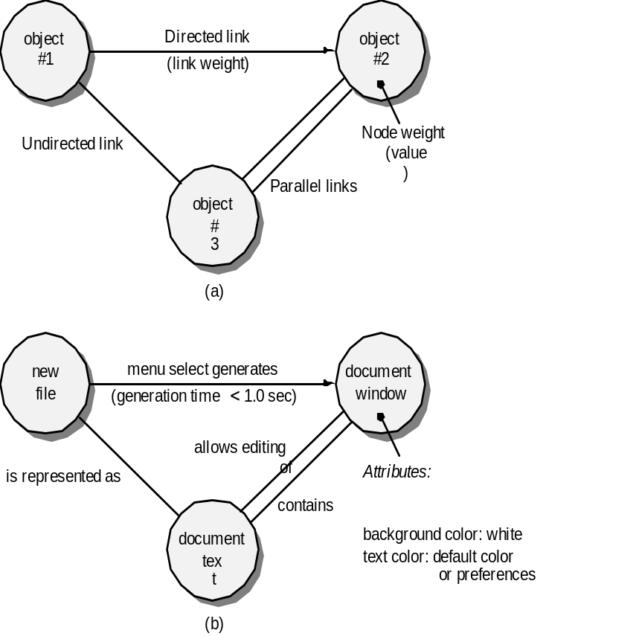
Graph-Based Methods
To understand the objects that are modeled in software and the relationships that connect these objects
In this context, we consider the term “objects” in the broadest possible context. It encompasses data objects, traditional components (modules), and object-oriented elements of computer software.

Slide 24
Equivalence Partitioning:
Equivalence Partitioning:
  Divide input domain into classes of data.
  Each test case then uncovers whole classes of errors.
  Examples: valid data (user supplied commands, file names, graphical data (e.g., mouse picks)), invalid data (data outside bounds of the program, physically impossible data, proper value supplied in wrong place)

Slide 25
Equivalence Partitioning
user
queries
output
formats
FK
input
mouse
picks
data
prompts

Slide 26
Sample Equivalence Classes
Valid data
user supplied commands
responses to system prompts
file names
computational data
physical parameters
bounding values
initiation values
output data formatting
responses to error messages
graphical data (e.g., mouse picks)
Invalid data
data outside bounds of the program
physically impossible data
proper value supplied in wrong place

Slide 27
Equivalence classes may be defined according to the following guidelines
If an input condition specifies a range, one valid and two invalid equivalence classes are defined.
If an input conditions requires a specific value, one valid and two invalid equivalence classes are required.
If an input condition specifies a member of a set, one valid and one invalid equivalence class are defined.
If an input condition is boolean, one valid and one invalid class are defined.

Slide 28
Boundary Value Analysis
user
queries
output
formats
FK
input
mouse
picks
data
prompts
output
domain
input domain

Slide 29
Boundary Value Analysis
If an input condition specifies a range bounded by values a and b, test cases should be designed with values a and b and just above and just below a and b.
If an input condition specifies a number of values, test cases should be developed that exercise the minimum and maximum numbers. Values just above and below minimum and maximum are also tested.

Slide 30
Boundary Value Analysis
Apply guidelines 1 and 2 to output conditions.
If internal program data structures have prescribed boundaries( eg. A table has defined limit of 100 entries), be certain to design a test case to exercise the data structure at its boundaries.

Slide 31
McCall’s Quality factors
Correctness
Reliability
Usability
Efficiency
Integrity
Maintainability
Flexibility
Testability
Reusability
Portability
Interoperability

